Slide 1
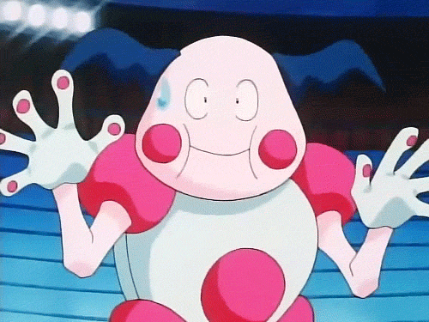
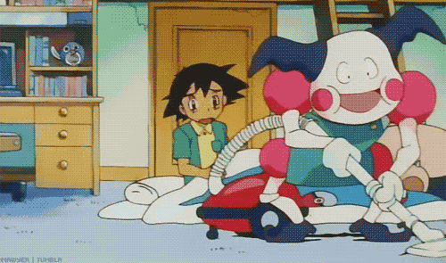
Hi! I’m Mr. Mime. Let’s finish Starter Unit!

Slide 2
【第二週英語作業】
聽: CD1(第5~12首)，每聽3遍請家長簽一次名。
背:複習以前學過的單字，下週單字道館開放挑戰。
寫:完成英語習作P43~P45。

Slide 3
Story Time Review Let’s read aloud!!!!

Slide 4
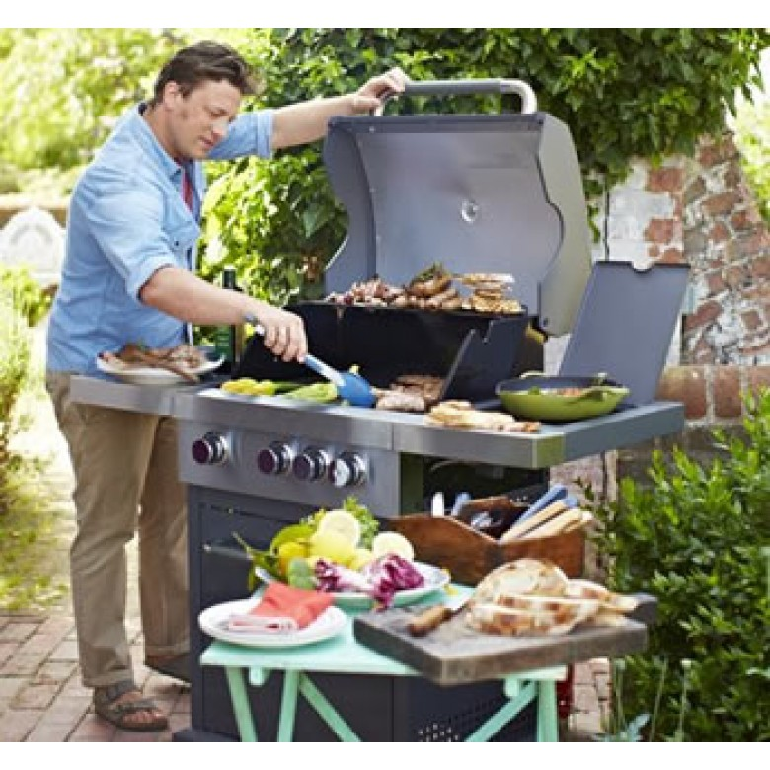
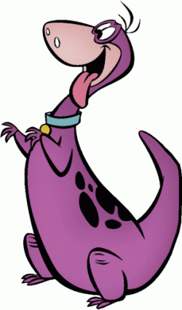
I want some bread and some hot dogs.
What do you want, Dino?

Slide 5
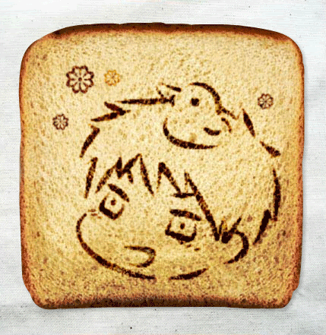
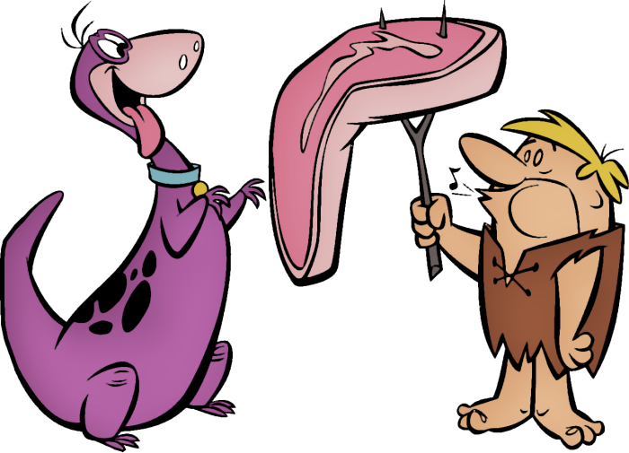
Mmm...Yummy!

Slide 6
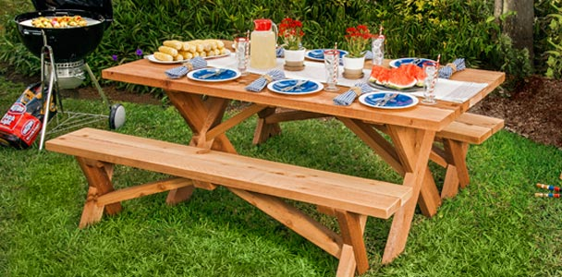
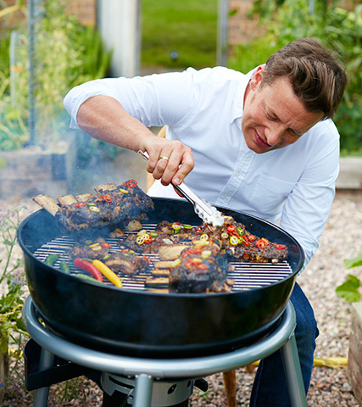
Of course he is.
Your brother is a good cook.

Slide 7
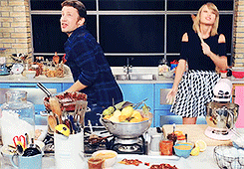
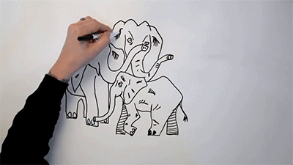
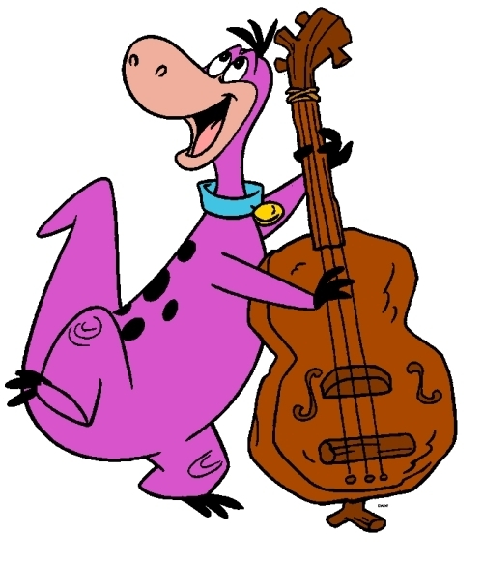
Me, too.
He can sing and draw, too.

Slide 8
Ted: What do you want, Dino?
Dino: I want some bread and some hot dogs.
Dino: Mmm...Yummy!
Niki: Your brother is a good cook.
Irene: Of course he is.
Irene: He can sing and draw, too.
Dino: Me, too.

Slide 9
Let’s sing Pokémon theme song!
Gotta catch 'em all
Gotta = got to
意思是「必須」去做某事
'em＝them

Slide 12
Phonics Time p4~5

Slide 13
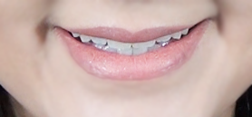
a
a
e

Slide 14
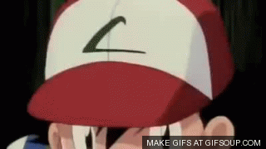
c
p
a

Slide 15
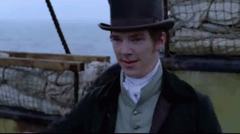
h
t
a

Slide 16
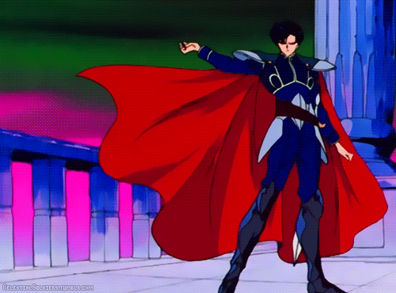
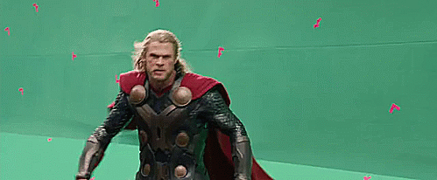
c
p
a
e

Slide 17
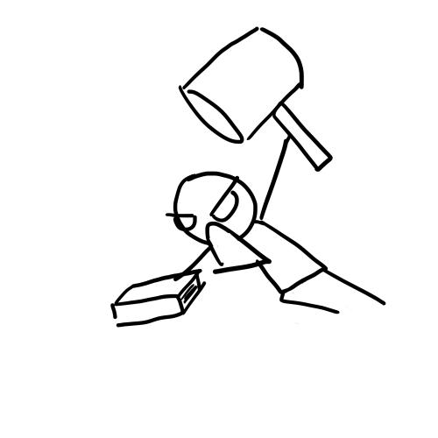
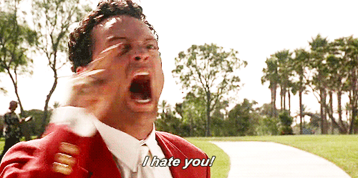
h
t
a
e

Slide 18
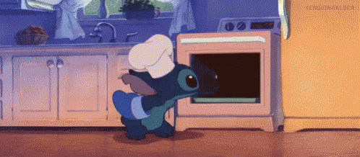
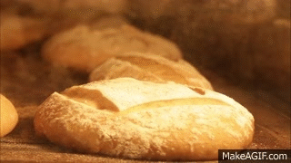
b
k
a
e

Slide 19
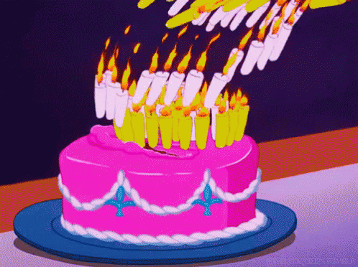
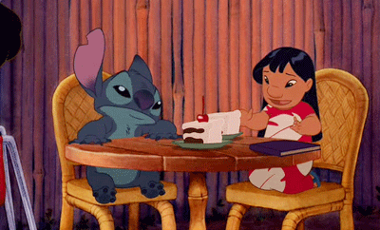
c
k
a
e

Slide 20
This is a cape.
That is a hat.
I like the cape.
I hate the hat.

Slide 21
a
e
a

Slide 22
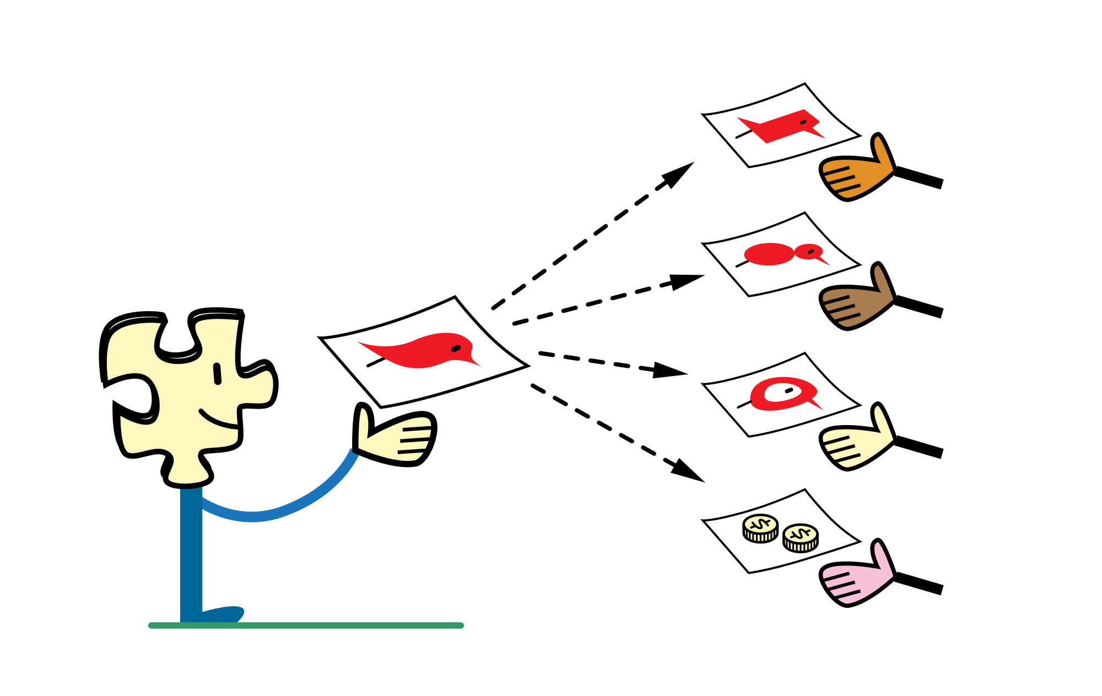
Challenge!!!
Listen and hand out the answer!

Slide 23
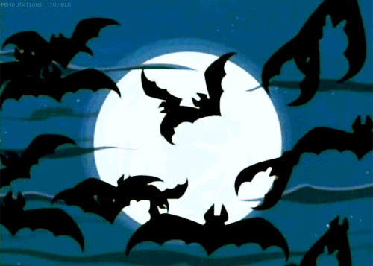

Slide 24
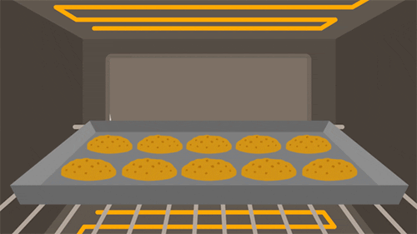

Slide 25
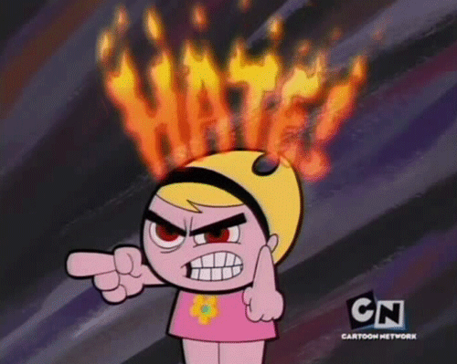

Slide 27
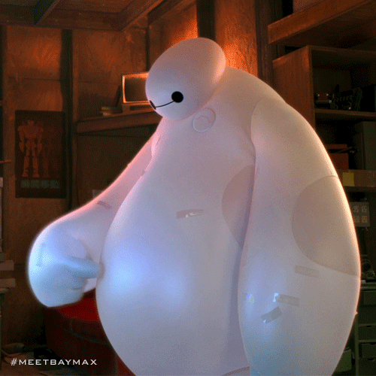

Slide 29
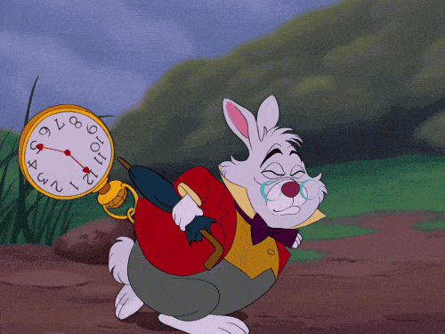

Slide 30
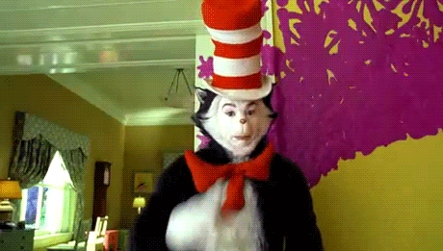

Slide 32
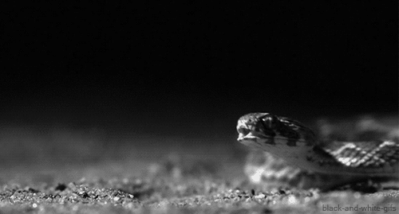

Slide 33
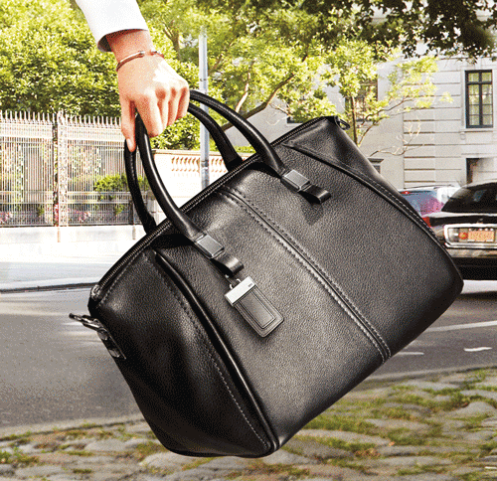

Slide 35
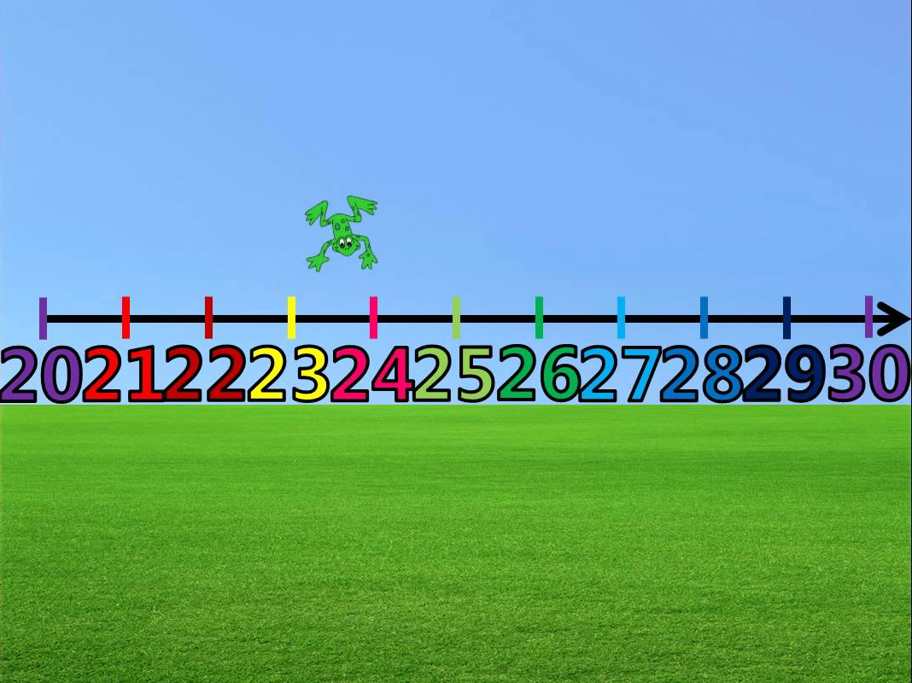
Let’s count! P6

Slide 36
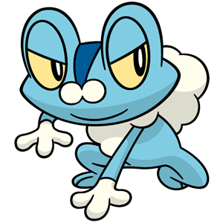
twenty

Slide 37
thirty

Slide 38
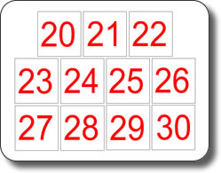
twenty
twenty-one
twenty-two
twenty-three
twenty-four
twenty-five
twenty-six
twenty-seven
twenty-eight
twenty-nine
thirty

Slide 39
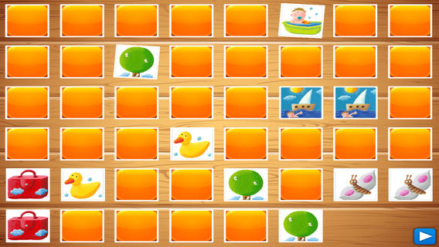
Card matching Game

